Slide 1
{Title}
{Text}
Notes:
Sunday Service Title

Slide 2
{Title}
{Text}
Notes:
Monthly Scripture

Slide 3
{Title}
{Text}
Notes:
Announcements

Slide 4
{Title}
{Text}
Notes:
Bible Verse Memorization

Slide 5
{Title}
{Text}
Notes:
Catechism

Slide 6
{Title}
{Text}
Notes:
Bible Verse Memorization (Next Week)

Slide 7
{Title}
{Text}
Notes:
Catechism (Next Week)

Slide 8
{Title}
{Text}
Notes:
Worship

Slide 9
{Title}
{Text}
Notes:
Call to Worship

Slide 10

{Title}
{Text}
Notes:
Hymn 1

Slide 11

{Title}
{Text}
Notes:
Prayer of Confession

Slide 12
THE LORD’S PRAYER
Our Father in heaven,
Hallowed be Your name.
Your kingdom come,
Your will be done,
On Earth as it is in heaven.
Give us this day our daily bread.
Notes:
The Lord’s Prayer PT 1

Slide 13
THE LORD’S PRAYER
And forgive us our debts,
as we also have forgiven our debtors.
And lead us not into temptation,
but deliver us from evil.
For Yours is the kingdom, the power,
the glory, forever.
Amen
Notes:
The Lord’s Prayer PT 2

Slide 14
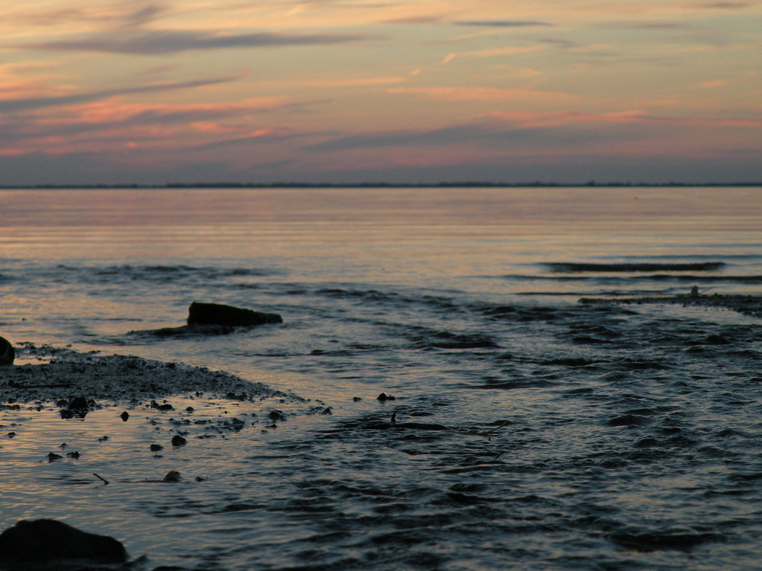
{Title}
{Text}
Notes:
Hymn 2

Slide 15
HOLY COMMUNION
Notes:
Holy Communion Title

Slide 16
1 CORINTHIANS 11:23-29
²³ For I received from the Lord what I also
delivered to you, that the Lord Jesus on the
night when he was betrayed took bread,
²⁴ and when he had given thanks, he broke it,
and said, “This is my body, which is for you.
Do this in remembrance of me.”
²⁵ In the same way also he took the cup, after
supper, saying, “This cup is the new
covenant in my blood. Do this, as often as
you drink it, in remembrance of me.”
Notes:
Holy Communion Verses PT 1

Slide 17
1 CORINTHIANS 11:23-29
²⁶ For as often as you eat this bread and drink
the cup, you proclaim the Lord’s death until
he comes.
²⁷ Whoever, therefore, eats the bread or drinks
the cup of the Lord in an unworthy manner
will be guilty concerning the body and blood
of the Lord.
²⁸ Let a person examine himself, then, and so
eat of the bread and drink of the cup.
²⁹ For anyone who eats and drinks without
discerning the body eats and drinks
judgment on himself.
Notes:
Holy Communion Verses PT 2

Slide 18
APOSTLE’S CREED
I believe in God, the Father almighty, the creator of heaven and earth. I believe in Jesus Christ, his only Son, our Lord, who was conceived by the Holy Spirit and born of the virgin Mary. He suffered under Pontius Pilate, was crucified, died, and was buried; he descended to hell. The third day he rose again from the dead.
Notes:
Apostle’s Creed PT 1

Slide 19
APOSTLE’S CREED
He ascended to heaven and is seated at the right hand of God the Father almighty. From there he will come to judge the living and the dead. I believe in the Holy Spirit, the holy catholic church, the communion of saints, the forgiveness of sins, the resurrection of the body and the life everlasting. Amen.
Notes:
Apostle’s Creed PT 2

Slide 20
{Title}
{Text}
Notes:
Sermon Title

Slide 21
{Title}
{Text}
Notes:
Sermon Verses

Slide 22

{Title}
{Text}
Notes:
Hymn 3

Slide 23
OFFERING
“Each of you should give what you have decided in your heart to give, not reluctantly or under compulsion, for God loves a cheerful giver.”
—2 Corinthians 9:7
Notes:
Offering

Slide 24
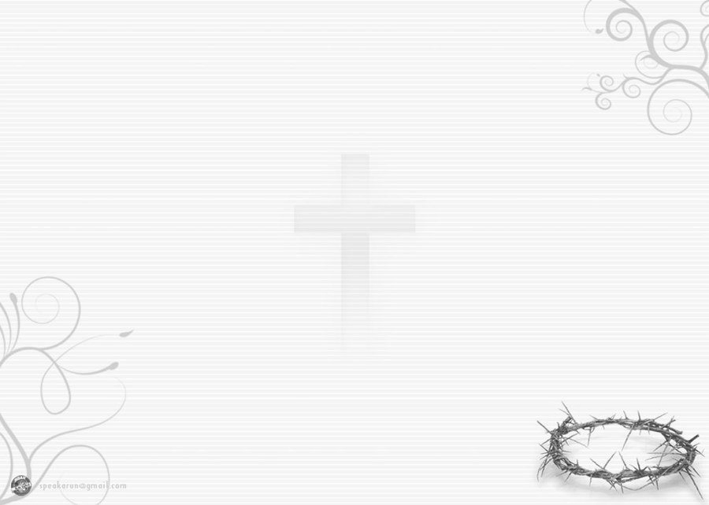
{Title}
{Text}
Notes:
Hymn 4

Slide 25
DOXOLOGY
Praise God, from whom all blessing flow
Praise Him, all creatures here below
Praise Him above, ye heavenly hosts
Praise Father, Son and Holy Ghost
Amen
Notes:
Doxology

Slide 26
BENEDICTION
Notes:
Benediction

Slide 27
NEXT WEEK’S SCHEDULE
 | {Date}
Speaker | {Speaker}
Worship Leader | {Leader}
Accompanist | {Accompanist}
Streaming | {Streaming}
Announcer | {Announcer}
Notes:
Next Week’s Schedule

